Slide 1
Have Fun and Stay Safe!

Slide 2
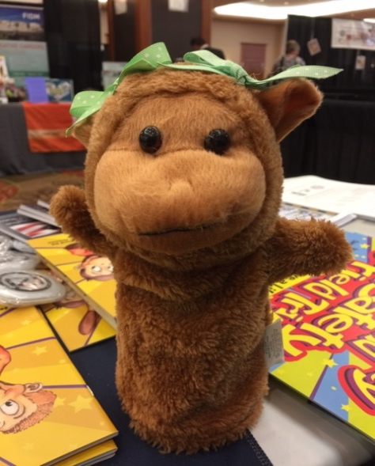
Course Objectives
Overall Goal: Learn about traffic safety while having fun!
What are safe and unsafe behaviors?
Reading about safety!
Playing some fun games with safety in mind!

Slide 3
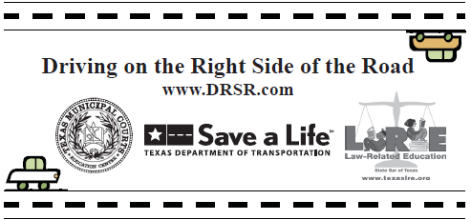
Driving on the Right Side of the Road – For Teachers, Courts, and Community Groups!
Program to teach kids safe behaviors while
Walking to school
Riding the bus
Riding their bikes/skateboards
Riding in cars
Uses the TEKS (Texas Essential Knowledge and Skills) that teacher MUST teach their students
We do this by conducting teacher “in-service”
Administered by the Texas Municipal Courts Education Center in Austin
Funded by TxDOT
Free stuff for classrooms and courts!
Children’s books on traffic safety
K-12 Lessons
Mock Trial Guidebooks
Much more!

Slide 4
Activity #1 – DWI LOTERIA
Played like regular bingo!
Prizes!!!
After the game –
Name one thing you learned about DUI that you didn’t know before the game.
What are you going to do to stay safe?

Slide 5
Activity #2 – Our Town Map
Get into pairs.
Look at your map.
Find 5 examples of SAFE behavior. Write down the grid space where this SAFE behavior can be found. Be sure to write the number before the letter.
Now find 5 examples of UNSAFE behavior. Write down the grid space where these behaviors are found.
Each group should be ready to share their findings.
What do you know now about SAFE and UNSAFE behaviors that you didn’t know before?

Slide 6
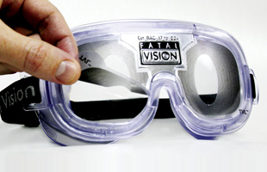
Activity #3 – Impaired Vision Goggles
Try to hit the hole with the beanbag.
Try again this time wearing the impairment goggles.
What is different about the two attempts?
Think about driving and feeling like you did when you were wearing the goggles.
Could you be safe feeling this way?

Slide 7
Reading about Safety!
Read pages 1 – 4
What safety rule do you remember from this part of the book?
Read pages 5 – 6
What safety rule do you remember from this part of the book?
Read pages 7 – 10
What safety rule do you remember from this part of the book?
Read pages 11 – 14
What safety rule do you remember from this part of the book?
Read pages 15 – 22
What safety rule do you remember from this part of the book?
What do you think is the purpose of this book?

Slide 8
Contact us if you need more materials!!!
Elizabeth De La Garza – elizabeth@tmcec.com
Ned Minevitz – ned@tmcec.com
WWW.DRSR.INFO
TMCEC.COM/MTSI

