Slide 1
Judicial Demeanor
Judge Glenn D. Phillips
City of Kilgore

Slide 2
Judicial Demeanor
“Important as it is that people should get justice, it is even more important that they be made to feel and see that they are getting it.”

Slide 3
A Good Judge
Appears to be fair and impartial
Appears to listen to the parties
Appears professional (looks like he knows what he is doing)
Is polite
Controls his or her courtroom
Is patient
Is dignified
Has respect for parties and witnesses’ feelings

Slide 4
Judicial Ethics
Thou Shalt Not (Lowest Standard)
  Take gifts, unless*
  Raise funds
  Endorse political candidates
  Consider ex parte communication
  Hear a case if biases
  Appear to behave improperly
Thou Shalt Not (Higher Standard)
  Respect and follow law
  Maintain order
  Be fair and impartial
  Treat every case as important
  Be patient, dignified, and courteous

Slide 5
Commission Structure
The Commission has 13 members:
  6 judges appointed by the Supreme Court
  5 citizens appointed by the Governor
  2 lawyers appointed by the State Bar

Slide 6
Commission Structure
Six-year staggered terms
Voluntary, unpaid service
Appointments are confirmed by the Texas Senate

Slide 7
Commission Staff
Executive Director
General Counsel
4 Staff Attorneys
3 Investigators
1 Legal Assistant
2 Support Staff

Slide 8
Mission Statement
  Protect the public
  Promote public confidence in the integrity, independence, competence, and impartiality of the judiciary
  Encourage judges to maintain high standards of conduct both on and off the bench.

Slide 9
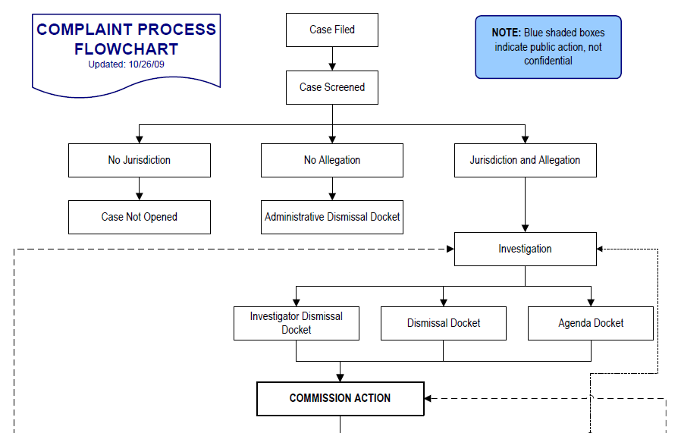
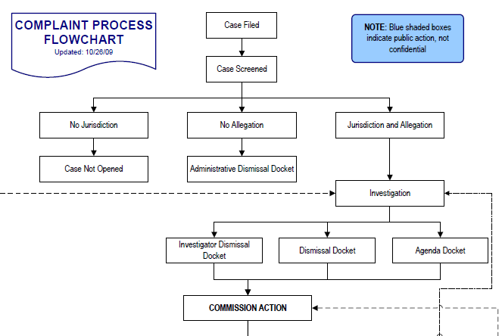

Slide 10
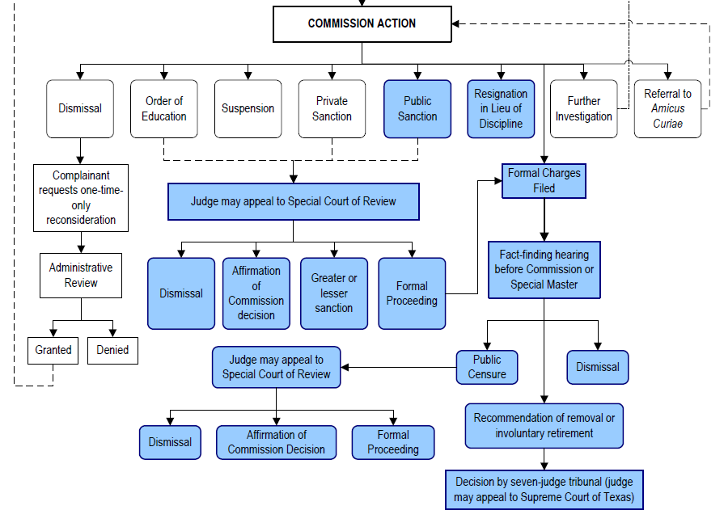

Slide 11
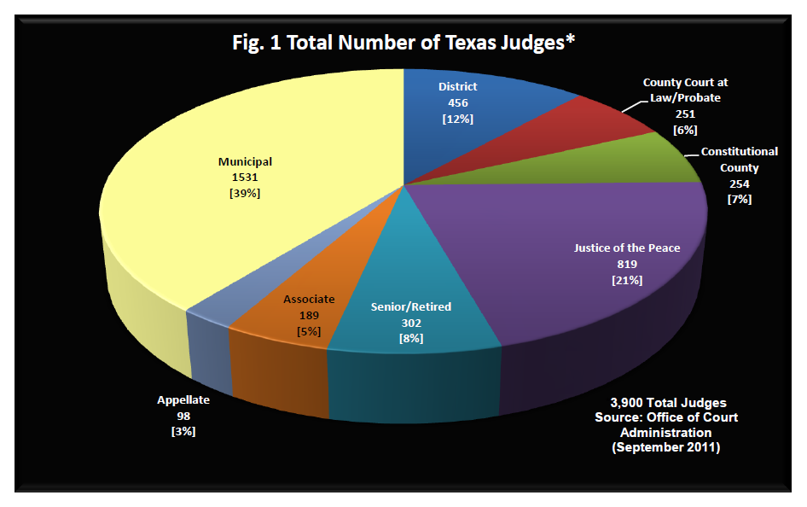

Slide 12
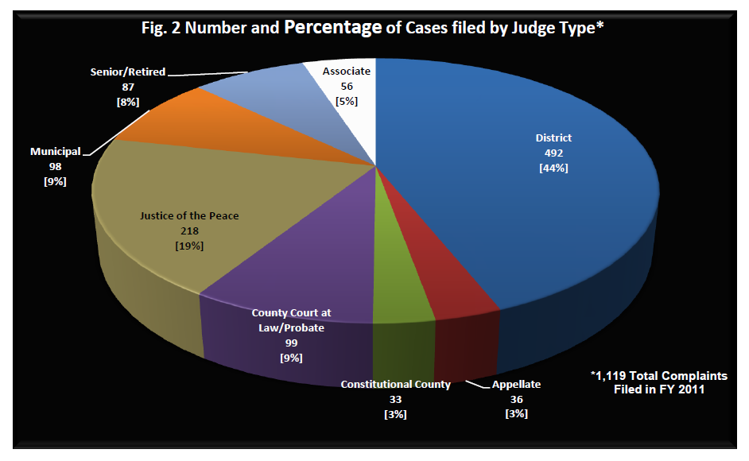

Slide 13
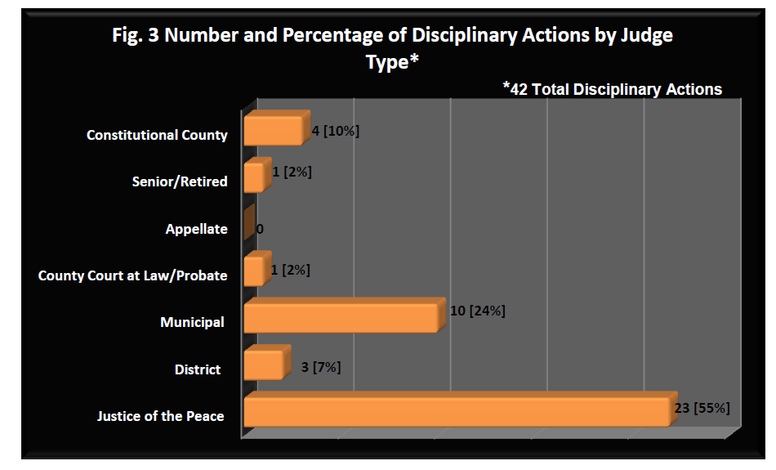

Slide 14
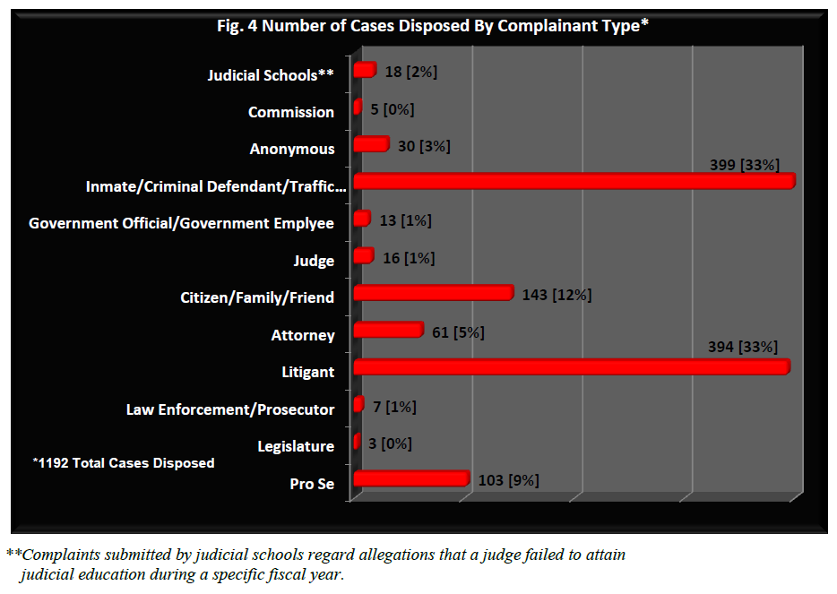

Slide 15
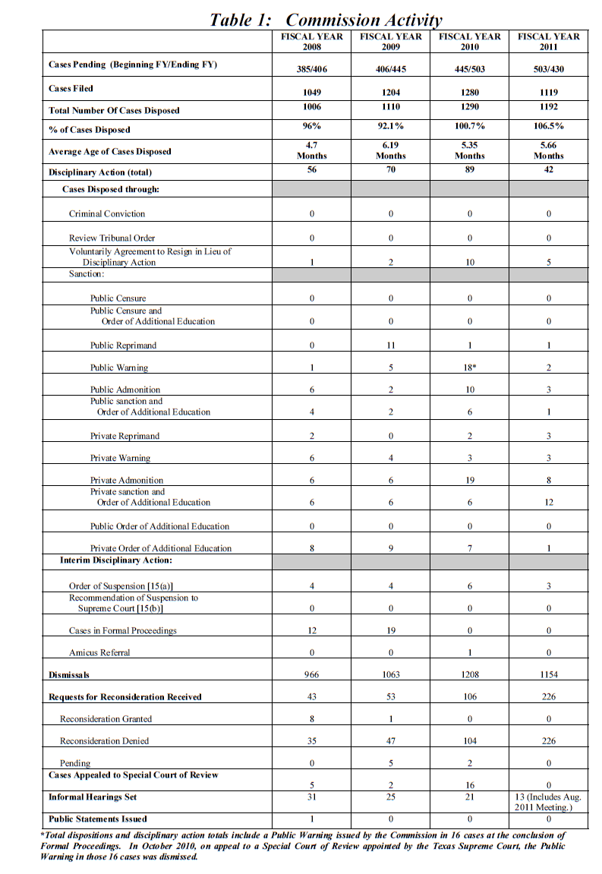

Slide 17
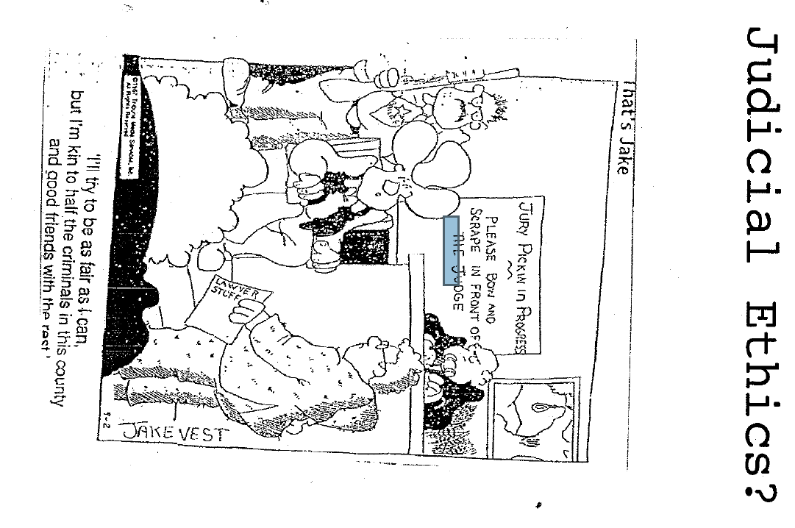

Slide 18
Hypothetical One
On Saturday afternoon, Judge Joe was at home, mowing his yard, when he got a call from the Police Department asking if he could come to court to magistrate several defendants who had been arrested for possession of dangerous drugs. A local civic group had recently passed out t-shirts bearing a slogan “Down With Dope, Up With Hope” and Judge Joe was wearing the t-shirt while mowing the yard. Since it was a Saturday Judge Joe did not change clothes and drove to the court to magistrate the defendants.

Slide 19
Hypothetical One, continued
When he arrived he went straight to the courtroom, without donning his robe. The Judge was surprised that several members of the civic group were in the courtroom when the prisoners were brought in to see the Judge. A TV photographer was also present. That night the TV station ran a story on the defendants, prominently showing Judge Joe in his “Down With Dope, Up With Hope” t-shirt. A Municipal Judge from an adjacent county saw the news story and on Monday filed a complaint on Judge Joe with the Commission. Result?

Slide 20
Hypothetical Two
On Tuesday, Judge Joe went to the Smallville jail to perform his magistrate duties on the defendants arrested overnight. The first prisoner was charged with Class C disorderly conduct. When Judge Joe introduced himself the defendant immediately informed Judge Joe that Ace Smith was his attorney and he wanted to contact Ace before proceeding.

Slide 21
Hypothetical Two, continued
Judge Joe actually despised Ace, but concealed his feelings and informed the defendant that an attorney was not necessary and demanded that the defendant enter a plea. Later that day, Ace, who despised Judge Joe, was informed that the defendant had wanted to contact him before entering a plea. Ace immediately fired off a letter of complaint to the Commission. Result?

Slide 22
Hypothetical Three
On Monday, Judge Joe’s first case involves an assault by threat case. A woman is accused of threatening her former spouse at a local bar. On cross-examination the victim admits that he was too drunk to recall what happened and there were no other witnesses. Judge Joe renders his verdict of acquital for the woman.

Slide 23
Hypothetical Three, continued
As Judge Joe was leaving the courtroom, the woman approached him to thank him for the acquittal and gives Judge Joe a big hug and a kiss. A startled Judge Joe excuses himself while giving his bailiff an angry look. This time the former husband is not too drunk to recall what happened and immediately filed a complaint with the Commission. Result?

Slide 24
Hypothetical Four
Each year the Bigtown Bar Association held a Christmas Party and Judge Bob was always invited. Judge Bob enjoyed a substantial quantity of Crown Royal, but was not disorderly and behaved as a gentleman. Judge Bob drove himself home. Shortly thereafter, Judge Bob received a notification from the Commission that he had been accused of getting drunk in public at the Christmas Party and driving while he was drunk. The Complaint was anonymous. Result?

Slide 25
Hypothetical Five
The Bigtown TV station conducted an annual charity event where prominent citizens were “jailed” and “fined” to raise money for a charitable cause. The TV station approached Judge Bob and requested him to be the “on air” Judge who would set the fines for the “jailed” citizens. Judge Bob had a conflict and declined, but the local JP accepted the opportunity for some free publicity and participated in the event. A formerly unsuccessful candidate for the JP job saw the program and filed a complaint against the JP with the Commission. Result?

Slide 26
Hypothetical Five, continued
The following week Judge Bob did participate as a panelist on a TV program honoring the American system of justice and discussed potential improvements to the judicial system.
What would the result have been if a complaint had been filed?

Slide 27
Hypothetical Six
Due to budget cuts, the Smallville Police Department was severely under funded. The Police Chief called Judge Joe and requested that the Judge appear with him at the press conference at City Hall to inform the public that the city desperately needed additional police officers.

Slide 28
Hypothetical Six, continued
Judge Joe complied and the next day a news story, along with a photo of the Chief and Judge Joe, in his robe, standing in front of City Hall was in many newspapers in the State. A Municipal Judge in another city, over 400 miles away saw the photo and took offense to Judge Joe appearing at the press conference in his robe, so he sent the photo to the Commission.

Slide 29
Hypothetical Seven
The City provided Judge Joe with letterhead which clearly identified Joe as a “Judge”. Judge Joe used the letterhead to write to his favorite fishing guide in Del Rio to confirm a date to go fishing. A city staff member was incensed that Judge Joe would use his “Judge” letterhead for personal business and secretly filed a complaint with the Commission. Result?

Slide 30
Hypothetical Eight
Judge Joe’s friend, Jeff, decides to run for District Judge. Judge Joe is smart enough to know that he cannot endorse Jeff, but Judge Joe’s wife, Melissa, wants to help out so she arranges to hold a fund raiser for Jeff at her residence. Jeff’s opponent feels that Judge Joe is endorsing Jeff and files a complaint with the Commission. Result?

Slide 31
Hypothetical Nine
Judge Joe is really busy this year and he just does not get around to attending the mandatory judicial education. The Education Center notifies the Commission.
Result?

Slide 32
Hypothetical Ten
In Bigtown the Municipal Court staff is under the control of an administrator, rather than Judge Bob. Ace, a local defense lawyer, had made several requests for court documents related to a case in Municipal Court. The Court Administrator found the requests to be frivolous and simply did not respond to the requests. Ace filed a complaint on Judge Bob with the Commission. Result?

Slide 33
Hypothetical Eleven
Judge Joe is really a stickler for defendants charged with theft. His lawnmower and fishing tackle were stolen from his garage last year and he just does not like theives.
A defendant is arrested at WalMart for Class B misdemeanor theft in Smallville. Judge Joe decides to teach the guy a lesson and sets his bond at $100,000. The defendant’s sister is a lawyer and decides to teach Judge Joe a lesson so she files a complaint with the Commission. Result?

Slide 34
Hypothetical Twelve
The owner of Blacky’s Bail Bond Company went to Judge Bob’s office at the Court to present an affidavit of surrender to Judge Bob for signature. The Judge signed the affidavit, which released Blacky from any further liability on a $10,000 bail bond which had been set by Judge Bob. Neither Judge Bob nor Blacky notified the District Attorney of the meeting at Judge Bob’s office.

Slide 35
Hypothetical Twelve, continued
When the Assistant District Attorney on the case learned that Judge Bob had met with Blacky and approved the affidavit of surrender, the prosecutor filed a complaint with the Commission accusing Judge Bob of having ex parte contacts on a case. Result?

Slide 36
Hypothetical Thirteen
Fine collections were slow in Bigtown, so the Court Administrator prepared a form letter with a facsimile of Judge Bob’s signature. The letter advised that the defendant had failed to pay the fine and faced immediate jail time if the fine was not paid. The letter was sent to a large number of defendants who did in fact owe fines. Judge Bob was not aware of the letter. A recipient of the letter filed a complaint with the Commission. Result?

Slide 37
Hypothetical Fourteen
From time to time couples would show up at Judge Bob’s court and request that Judge Bob perform their marriage. Judge Bob would accommodate them during breaks in court proceedings and routinely collected $50.00 in cash, which he placed in his wallet. When the Court Administrator learned of this practice, she was incensed and immediately filed a complaint with the Commission and sent an anonymous letter to the Internal Revenue Service. Result?

Slide 38
Hypothetical Fifteen
Judge Joe is the Municipal Judge of Smallville, a suburb of Bigtown, where the county jail is located. Defendants arrested in Smallville are magistrated by Judge Joe before being tranfered to the county jail in Bigtown. Judge Bob is the Municipal Judge in Bigtown and magistrates all defendants arrested in Bigtown.

Slide 39
Hypothetical Fifteen, continued
A defendant is arrested in Smallville for DWI and Judge Joe sets his bond at $1,000. The defendant is transfered to the county jail in Bigtown where Judge Bob unilaterally reduces the defendant’s bond to $500. A police officer in Smallville files a complaint with the Commission. Result?

Slide 40
Hypothetical Sixteen
Each year, several law firms in Bigtown engaged in a practice of giving Christmas gifts to local judges. Normally the gifts would be a bottle of wine or other beverage or a smoked turkey, a book or a gift of similar value. One year a new judge, of a different political party was appointed to the bench. This judge declined the gifts and reported the acceptance of gifts by the other judges (from the other political party) to the Commission. Result?

Slide 41
Hypothetical Seventeen
Judge Bob is a Methodist. Each year in Bigtown the Methodist Church has a Men’s Prayer Breakfast. One year Judge Bob participated in a TV commercial inviting local men to attend the breakfast event. Judge Bob was in his robe in the commercial. No solicitation of funds was involved in any way.

Slide 42
Hypothetical Seventeen, continued
The entire event was open to those of all religions and without charge. A Justice on the Court of Appeals saw the commercial and filed a complaint with the Commission on Judge Bob. The Justice was a member of the Commission and incidentally was a Methodist. Result?

Slide 43

Any Questions?

